Slide 1
Managing Objects with Data Dictionary Views

Slide 2
Objectives
After completing this lesson, you should be able to do the following:
  Use the data dictionary views to research data on your objects
  Query various data dictionary views
Notes:
Oracle Database 11g: SQL Fundamentals II 3 - <number>
Objectives
In this lesson, you are introduced to the data dictionary views. You learn that the dictionary views can be used to retrieve metadata and create reports about your schema objects.

Slide 3
Lesson Agenda
  Introduction to data dictionary
  Querying the dictionary views for the following:
    Table information
    Column information
    Constraint information
  Querying the dictionary views for the following:
    View information
    Sequence information
    Synonym information
    Index information
  Adding a comment to a table and querying the dictionary views for comment information
Notes:
Oracle Database 11g: SQL Fundamentals II 3 - <number>

Slide 4

Data Dictionary
Oracle Server
Tables containing business data:
EMPLOYEES
DEPARTMENTS
LOCATIONS
JOB_HISTORY
...
Data dictionary views:
DICTIONARY
USER_OBJECTS
USER_TABLES
USER_TAB_COLUMNS
...
Notes:
Oracle Database 11g: SQL Fundamentals II 3 - <number>
Data Dictionary
User tables are tables created by the user and contain business data, such as EMPLOYEES. There is another collection of tables and views in the Oracle database known as the data dictionary. This collection is created and maintained by the Oracle Server and contains information about the database. The data dictionary is structured in tables and views, just like other database data. Not only is the data dictionary central to every Oracle database, but it is also an important tool for all users, from end users to application designers and database administrators.
You use SQL statements to access the data dictionary. Because the data dictionary is read-only, you can issue only queries against its tables and views.
You can query the dictionary views that are based on the dictionary tables to find information such as:
Definitions of all schema objects in the database (tables, views, indexes, synonyms, sequences, procedures, functions, packages, triggers, and so on)
Default values for columns
Integrity constraint information
Names of Oracle users
Privileges and roles that each user has been granted
Other general database information

Slide 5
Data Dictionary Structure
Oracle Server
Consists of:
Base tables
User-accessible views
Notes:
Oracle Database 11g: SQL Fundamentals II 3 - <number>
Data Dictionary Structure
Underlying base tables store information about the associated database. Only the Oracle Server should write to and read from these tables. You rarely access them directly.
There are several views that summarize and display the information stored in the base tables of the data dictionary. These views decode the base table data into useful information (such as user or table names) using joins and WHERE clauses to simplify the information. Most users are given access to the views rather than the base tables.
The Oracle user SYS owns all base tables and user-accessible views of the data dictionary. No Oracle user should ever alter (UPDATE, DELETE, or INSERT) any rows or schema objects contained in the SYS schema because such activity can compromise data integrity.

Slide 6
Data Dictionary Structure
View naming convention:
View Prefix | Purpose
USER | User’s view (what is in your schema; what you own)
ALL | Expanded user’s view (what you can access)
DBA | Database administrator’s view (what is in everyone’s schemas)
V$ | Performance-related data
Notes:
Oracle Database 11g: SQL Fundamentals II 3 - <number>
Data Dictionary Structure (continued)
The data dictionary consists of sets of views. In many cases, a set consists of three views containing similar information and distinguished from each other by their prefixes. For example, there is a view named USER_OBJECTS, another named ALL_OBJECTS, and a third named DBA_OBJECTS.
These three views contain similar information about objects in the database, except that the scope is different. USER_OBJECTS contains information about objects that you own or created. ALL_OBJECTS contains information about all objects to which you have access. DBA_OBJECTS contains information about all objects that are owned by all users. For views that are prefixed with ALL or DBA, there is usually an additional column in the view named OWNER to identify who owns the object.
There is also a set of views that is prefixed with v$. These views are dynamic in nature and hold information about performance. Dynamic performance tables are not true tables, and they should not be accessed by most users. However, database administrators can query and create views on the tables and grant access to those views to other users. This course does not go into details about these views.

Slide 7
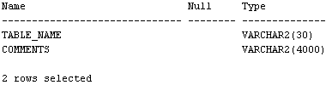

How to Use the Dictionary Views
Start with DICTIONARY. It contains the names and descriptions of the dictionary tables and views.
DESCRIBE DICTIONARY
SELECT *
FROM dictionary
WHERE table_name = 'USER_OBJECTS';
Notes:
Oracle Database 11g: SQL Fundamentals II 3 - <number>
How to Use the Dictionary Views
To familiarize yourself with the dictionary views, you can use the dictionary view named DICTIONARY. It contains the name and short description of each dictionary view to which you have access.
You can write queries to search for information about a particular view name, or you can search the COMMENTS column for a word or phrase. In the example shown, the DICTIONARY view is described. It has two columns. The SELECT statement retrieves information about the dictionary view named USER_OBJECTS. The USER_OBJECTS view contains information about all the objects that you own.
You can write queries to search the COMMENTS column for a word or phrase. For example, the following query returns the names of all views that you are permitted to access in which the COMMENTS column contains the word columns:
SELECT table_name
FROM dictionary
WHERE LOWER(comments) LIKE '%columns%';
Note: The names in the data dictionary are in uppercase.

Slide 8
USER_OBJECTS and ALL_OBJECTS Views
USER_OBJECTS:
  Query USER_OBJECTS to see all the objects that you own.
  Using USER_OBJECTS, you can obtain a listing of all object names and types in your schema, plus the following information:
    Date created
    Date of last modification
    Status (valid or invalid)
ALL_OBJECTS:
  Query ALL_OBJECTS to see all the objects to which you have access.
Notes:
Oracle Database 11g: SQL Fundamentals II 3 - <number>
USER_OBJECTS and ALL_OBJECTS Views
You can query the USER_OBJECTS view to see the names and types of all the objects in your schema. There are several columns in this view:
OBJECT_NAME: Name of the object
OBJECT_ID: Dictionary object number of the object
OBJECT_TYPE: Type of object (such as TABLE, VIEW, INDEX, SEQUENCE)
CREATED: Time stamp for the creation of the object
LAST_DDL_TIME: Time stamp for the last modification of the object resulting from a data definition language (DDL) command
STATUS: Status of the object (VALID, INVALID, or N/A)
GENERATED: Was the name of this object system generated? (Y|N)
Note: This is not a complete listing of the columns. For a complete listing, see “USER_OBJECTS” in the Oracle Database Reference.
You can also query the ALL_OBJECTS view to see a listing of all objects to which you have access.

Slide 9


USER_OBJECTS View
SELECT object_name, object_type, created, status
FROM user_objects
ORDER BY object_type;
…
…
Notes:
Oracle Database 11g: SQL Fundamentals II 3 - <number>
USER_OBJECTS View
The example shows the names, types, dates of creation, and status of all objects that are owned by this user.
The OBJECT_TYPE column holds the values of either TABLE, VIEW, SEQUENCE, INDEX, PROCEDURE, FUNCTION, PACKAGE, or TRIGGER.
The STATUS column holds a value of VALID, INVALID, or N/A. Although tables are always valid, the views, procedures, functions, packages, and triggers may be invalid.
The CAT View
For a simplified query and output, you can query the CAT view. This view contains only two columns: TABLE_NAME and TABLE_TYPE. It provides the names of all your INDEX, TABLE, CLUSTER, VIEW, SYNONYM, SEQUENCE, or UNDEFINED objects.
Note: CAT is a synonym for USER_CATALOG—a view that lists tables, views, synonyms and sequences owned by the user.

Slide 10
Lesson Agenda
  Introduction to data dictionary
  Querying the dictionary views for the following:
    Table information
    Column information
    Constraint information
  Querying the dictionary views for the following:
    View information
    Sequence information
    Synonym information
    Index information
  Adding a comment to a table and querying the dictionary views for comment information
Notes:
Oracle Database 11g: SQL Fundamentals II 3 - <number>

Slide 11

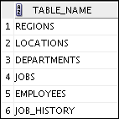
Table Information
USER_TABLES:
DESCRIBE user_tables
…
SELECT table_name
FROM user_tables;
…
Notes:
Oracle Database 11g: SQL Fundamentals II 3 - <number>
Table Information
You can use the USER_TABLES view to obtain the names of all your tables. The USER_TABLES view contains information about your tables. In addition to providing the table name, it contains detailed information about the storage.
The TABS view is a synonym of the USER_TABLES view. You can query it to see a listing of tables that you own:
SELECT table_name
FROM tabs;
Note: For a complete listing of the columns in the USER_TABLES view, see “USER_TABLES” in the Oracle Database Reference.
You can also query the ALL_TABLES view to see a listing of all tables to which you have access.

Slide 12
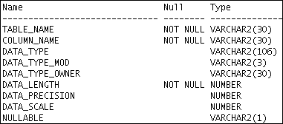
Column Information
USER_TAB_COLUMNS:
DESCRIBE user_tab_columns
…
Notes:
Oracle Database 11g: SQL Fundamentals II 3 - <number>
Column Information
You can query the USER_TAB_COLUMNS view to find detailed information about the columns in your tables. Although the USER_TABLES view provides information about your table names and storage, detailed column information is found in the USER_TAB_COLUMNS view.
This view contains information such as:
Column names
Column data types
Length of data types
Precision and scale for NUMBER columns
Whether nulls are allowed (Is there a NOT NULL constraint on the column?)
Default value
Note: For a complete listing and description of the columns in the USER_TAB_COLUMNS view, see “USER_TAB_COLUMNS” in the Oracle Database Reference.

Slide 13
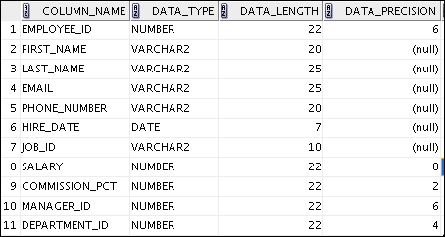
Column Information
SELECT column_name, data_type, data_length,
data_precision, data_scale, nullable
FROM user_tab_columns
WHERE table_name = 'EMPLOYEES';
Notes:
Oracle Database 11g: SQL Fundamentals II 3 - <number>
Column Information (continued)
By querying the USER_TAB_COLUMNS table, you can find details about your columns such as the names, data types, data type lengths, null constraints, and default value for a column.
The example shown displays the columns, data types, data lengths, and null constraints for the EMPLOYEES table. Note that this information is similar to the output from the DESCRIBE command.
To view information about columns set as unused, you use the USER_UNUSED_COL_TABS dictionary view.
Note: Names of the objects in Data Dictionary are in uppercase.

Slide 14
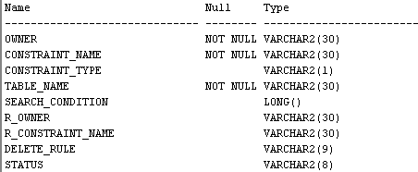
Constraint Information
  USER_CONSTRAINTS describes the constraint definitions on your tables.
  USER_CONS_COLUMNS describes columns that are owned by you and that are specified in constraints.
DESCRIBE user_constraints
…
Notes:
Oracle Database 11g: SQL Fundamentals II 3 - <number>
Constraint Information
You can find out the names of your constraints, the type of constraint, the table name to which the constraint applies, the condition for check constraints, foreign key constraint information, deletion rule for foreign key constraints, the status, and many other types of information about your constraints.
Note: For a complete listing and description of the columns in the USER_CONSTRAINTS view, see “USER_CONSTRAINTS” in the Oracle Database Reference.

Slide 15
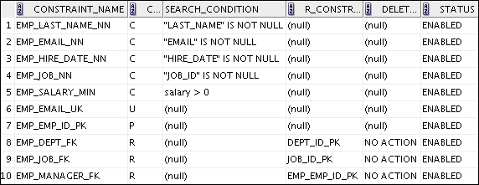
USER_CONSTRAINTS: Example
SELECT constraint_name, constraint_type,
search_condition, r_constraint_name,
delete_rule, status
FROM user_constraints
WHERE table_name = 'EMPLOYEES';
Notes:
Oracle Database 11g: SQL Fundamentals II 3 - <number>
USER_CONSTRAINTS: Example
In the example shown, the USER_CONSTRAINTS view is queried to find the names, types, check conditions, name of the unique constraint that the foreign key references, deletion rule for a foreign key, and status for constraints on the EMPLOYEES table.
The CONSTRAINT_TYPE can be:
C (check constraint on a table , or NOT NULL)
P (primary key)
U (unique key)
R (referential integrity)
V (with check option, on a view)
O (with read-only, on a view)
The DELETE_RULE can be:
CASCADE: If the parent record is deleted, the child records are deleted too.
SET NULL: If the parent record is deleted, change the respective child record to null.
NO ACTION: A parent record can be deleted only if no child records exist.
The STATUS can be:
ENABLED: Constraint is active.
DISABLED: Constraint is made not active.

Slide 16
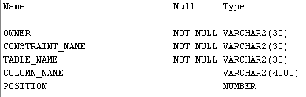
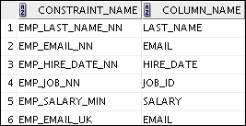
Querying USER_CONS_COLUMNS
DESCRIBE user_cons_columns
SELECT constraint_name, column_name
FROM user_cons_columns
WHERE table_name = 'EMPLOYEES';
…
Notes:
Oracle Database 11g: SQL Fundamentals II 3 - <number>
Querying USER_CONS_COLUMNS
To find the names of the columns to which a constraint applies, query the USER_CONS_COLUMNS dictionary view. This view tells you the name of the owner of a constraint, the name of the constraint, the table that the constraint is on, the names of the columns with the constraint, and the original position of column or attribute in the definition of the object.
Note: A constraint may apply to more than one column.
You can also write a join between USER_CONSTRAINTS and USER_CONS_COLUMNS to create customized output from both tables.

Slide 17
Lesson Agenda
  Introduction to data dictionary
  Querying the dictionary views for the following:
    Table information
    Column information
    Constraint information
  Querying the dictionary views for the following:
    View information
    Sequence information
    Synonym information
    Index information
  Adding a comment to a table and querying the dictionary views for comment information
Notes:
Oracle Database 11g: SQL Fundamentals II 3 - <number>

Slide 18


View Information
1
DESCRIBE user_views
2
SELECT view_name FROM user_views;
3
SELECT text FROM user_views
WHERE view_name = 'EMP_DETAILS_VIEW';
…
Notes:
Oracle Database 11g: SQL Fundamentals II 3 - <number>
View Information
After your view is created, you can query the data dictionary view called USER_VIEWS to see the name of the view and the view definition. The text of the SELECT statement that constitutes your view is stored in a LONG column. The LENGTH column is the number of characters in the SELECT statement. By default, when you select from a LONG column, only the first 80 characters of the column’s value are displayed. To see more than 80 characters in SQL*Plus, use the SET LONG command:
SET LONG 1000
In the examples in the slide:
1. The USER_VIEWS columns are displayed. Note that this is a partial listing.
2. The names of your views are retrieved
3. The SELECT statement for the EMP_DETAILS_VIEW is displayed from the dictionary
Data Access Using Views
When you access data by using a view, the Oracle Server performs the following operations:
It retrieves the view definition from the data dictionary table USER_VIEWS.
It checks access privileges for the view base table.
It converts the view query into an equivalent operation on the underlying base table or tables. That is, data is retrieved from, or an update is made to, the base tables.

Slide 19
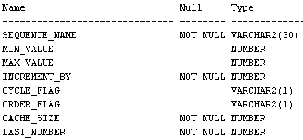
Sequence Information
DESCRIBE user_sequences
Notes:
Oracle Database 11g: SQL Fundamentals II 3 - <number>
Sequence Information
The USER_SEQUENCES view describes all sequences that you own. When you create the sequence, you specify criteria that are stored in the USER_SEQUENCES view. The columns in this view are:
SEQUENCE_NAME: Name of the sequence
MIN_VALUE: Minimum value of the sequence
MAX_VALUE: Maximum value of the sequence
INCREMENT_BY: Value by which the sequence is incremented
CYCLE_FLAG: Does sequence wrap around on reaching the limit?
ORDER_FLAG: Are sequence numbers generated in order?
CACHE_SIZE: Number of sequence numbers to cache
LAST_NUMBER: Last sequence number written to disk. If a sequence uses caching, the number written to disk is the last number placed in the sequence cache. This number is likely to be greater than the last sequence number that was used.

Slide 20

Confirming Sequences
  Verify your sequence values in the USER_SEQUENCES data dictionary table.
  The LAST_NUMBER column displays the next available sequence number if NOCACHE is specified.
SELECT sequence_name, min_value, max_value,
increment_by, last_number
FROM user_sequences;
Notes:
Oracle Database 11g: SQL Fundamentals II 3 - <number>
Confirming Sequences
After creating your sequence, it is documented in the data dictionary. Because a sequence is a database object, you can identify it in the USER_OBJECTS data dictionary table.
You can also confirm the settings of the sequence by selecting from the USER_SEQUENCES data dictionary view.
Viewing the Next Available Sequence Value Without Incrementing It
If the sequence was created with NOCACHE, it is possible to view the next available sequence value without incrementing it by querying the USER_SEQUENCES table.

Slide 21
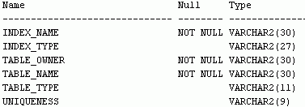
Index Information
  USER_INDEXES provides information about your indexes.
  USER_IND_COLUMNS describes columns comprising your indexes and columns of indexes on your tables.
DESCRIBE user_indexes
…
Notes:
Oracle Database 11g: SQL Fundamentals II 3 - <number>
Index Information
You query the USER_INDEXES view to find out the names of your indexes, the table name on which the index is created, and whether the index is unique.
Note: For a complete listing and description of the columns in the USER_INDEXES view, see “USER_INDEXES” in the Oracle Database Reference 11g Release 2 (11.1).

Slide 22
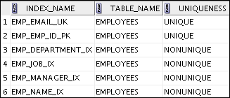

USER_INDEXES: Examples
a
SELECT index_name, table_name,uniqueness
FROM user_indexes
WHERE table_name = 'EMPLOYEES';
b
SELECT index_name, table_name
FROM user_indexes
WHERE table_name = 'emp_lib';
Notes:
Oracle Database 11g: SQL Fundamentals II 3 - <number>
USER_INDEXES: Example
In the slide example a, the USER_INDEXES view is queried to find the name of the index, name of the table on which the index is created, and whether the index is unique.
In the slide example b, observe that the Oracle Server gives a generic name to the index that is created for the PRIMARY KEY column. The EMP_LIB table is created by using the following code:
CREATE TABLE EMP_LIB
(book_id NUMBER(6)PRIMARY KEY ,
title VARCHAR2(25),
category VARCHAR2(20));

Slide 23
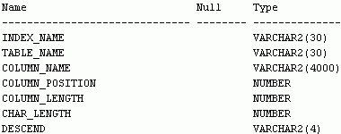

Querying USER_IND_COLUMNS
DESCRIBE user_ind_columns
SELECT index_name, column_name,table_name
FROM user_ind_columns
WHERE index_name = 'lname_idx';
Notes:
Oracle Database 11g: SQL Fundamentals II 3 - <number>
Querying USER_IND_COLUMNS
The USER_IND_COLUMNS dictionary view provides information such as the name of the index, name of the indexed table, name of a column within the index, and the column’s position within the index.
For the slide example, the emp_test table and LNAME_IDX index are created by using the following code:
CREATE TABLE emp_test AS SELECT * FROM employees;
CREATE INDEX LNAME_IDX ON emp_test(Last_Name);

Slide 24
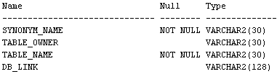

Synonym Information
DESCRIBE user_synonyms
SELECT *
FROM user_synonyms;
Notes:
Oracle Database 11g: SQL Fundamentals II 3 - <number>
Synonym Information
The USER_SYNONYMS dictionary view describes private synonyms (synonyms that you own).
You can query this view to find your synonyms. You can query ALL_SYNONYMS to find out the name of all the synonyms that are available to you and the objects on which these synonyms apply.
The columns in this view are:
SYNONYM_NAME: Name of the synonym
TABLE_OWNER: Owner of the object that is referenced by the synonym
TABLE_NAME: Name of the table or view that is referenced by the synonym
DB_LINK: Name of the database link reference (if any)

Slide 25
Lesson Agenda
  Introduction to data dictionary
  Querying the dictionary views for the following:
    Table information
    Column information
    Constraint information
  Querying the dictionary views for the following:
    View information
    Sequence information
    Synonym information
    Index information
  Adding a comment to a table and querying the dictionary views for comment information
Notes:
Oracle Database 11g: SQL Fundamentals II 3 - <number>

Slide 26
Adding Comments to a Table
  You can add comments to a table or column by using the COMMENT statement:
  Comments can be viewed through the data dictionary views:
    ALL_COL_COMMENTS
    USER_COL_COMMENTS
    ALL_TAB_COMMENTS
    USER_TAB_COMMENTS
COMMENT ON TABLE employees
IS 'Employee Information';
COMMENT ON COLUMN employees.first_name
IS 'First name of the employee';
Notes:
Oracle Database 11g: SQL Fundamentals II 3 - <number>
Adding Comments to a Table
You can add a comment of up to 4,000 bytes about a column, table, view, or snapshot by using the COMMENT statement. The comment is stored in the data dictionary and can be viewed in one of the following data dictionary views in the COMMENTS column:
ALL_COL_COMMENTS
USER_COL_COMMENTS
ALL_TAB_COMMENTS
USER_TAB_COMMENTS
Syntax
COMMENT ON {TABLE table | COLUMN table.column}
IS 'text';
In the syntax:
table Is the name of the table
column Is the name of the column in a table
text Is the text of the comment
You can drop a comment from the database by setting it to empty string (''):
COMMENT ON TABLE employees IS '';

Slide 27
Quiz
The dictionary views that are based on the dictionary tables contain information such as:
  Definitions of all the schema objects in the database
  Default values for the columns
  Integrity constraint information
  Privileges and roles that each user has been granted
  All of the above
Notes:
Oracle Database 11g: SQL Fundamentals II 3 - <number>
Answer: 5

Slide 28
Summary
In this lesson, you should have learned how to find information about your objects through the following dictionary views:
  DICTIONARY
  USER_OBJECTS
  USER_TABLES
  USER_TAB_COLUMNS
  USER_CONSTRAINTS
  USER_CONS_COLUMNS
  USER_VIEWS
  USER_SEQUENCES
  USER_INDEXES
  USER_SYNONYMS
Notes:
Oracle Database 11g: SQL Fundamentals II 3 - <number>
Summary
In this lesson, you learned about some of the dictionary views that are available to you. You can use these dictionary views to find information about your tables, constraints, views, sequences, and synonyms.

Slide 29
Practice 3: Overview
This practice covers the following topics:
  Querying the dictionary views for table and column information
  Querying the dictionary views for constraint information
  Querying the dictionary views for view information
  Querying the dictionary views for sequence information
  Querying the dictionary views for synonym information
  Querying the dictionary views for index information
  Adding a comment to a table and querying the dictionary views for comment information
Notes:
Oracle Database 11g: SQL Fundamentals II 3 - <number>
Practice 3: Overview
In this practice, you query the dictionary views to find information about objects in your schema.

